Slide 1
자료구조 및 알고리즘 - Graphs
Taehyoun Kim
Dept. of Mechanical & Information Engineering,
University of Seoul

Slide 2
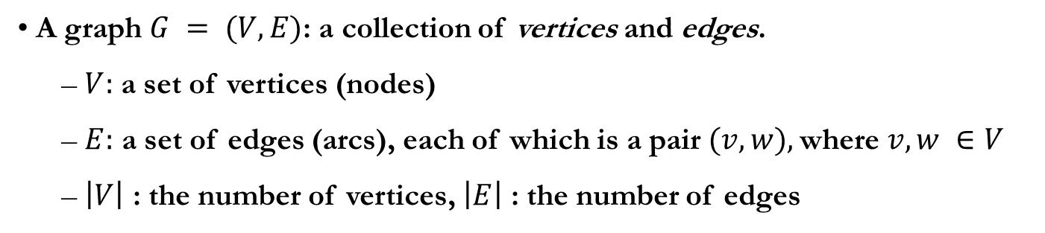
Graph Definitions
A graph $G = (V, E)$: a collection of vertices and edges.
$V:$ a set of vertices (nodes)
$E:$ a set of edges (arcs), each of which is a pair $(v, w),$where $v, w ∈V$
$\left|V\right|$ : the number of vertices, $\left|E\right|$ : the number of edges
V = {1, 2, 3}
E = {(1,1), (1,2), (2,3), (3,2), (1,3)}
V = {1, 2, 3, 4}
E = {{1,2}, {1,3}, {1,4}, {2,4}, {3,4}}
(1,1)
1
1
3
(1,2)
2
3
2
4

Slide 3
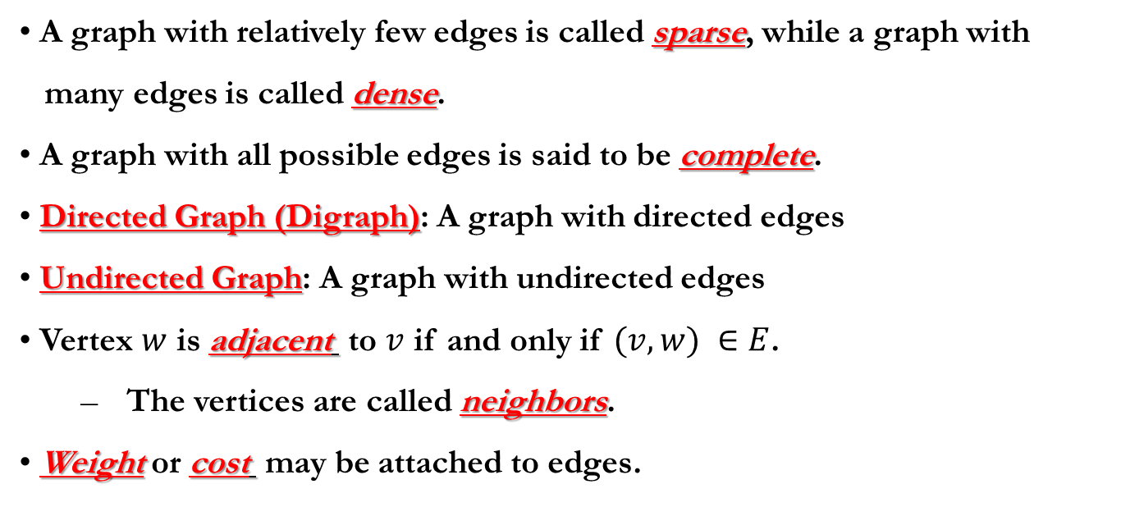
Graph: additional terms
A graph with relatively few edges is called sparse, while a graph with
many edges is called dense.
A graph with all possible edges is said to be complete.
Directed Graph (Digraph): A graph with directed edges
Undirected Graph: A graph with undirected edges
Vertex $w$ is adjacent to $v$ if and only if $(v, w) ∈E$.
The vertices are called neighbors.
Weight or cost may be attached to edges.

Slide 4
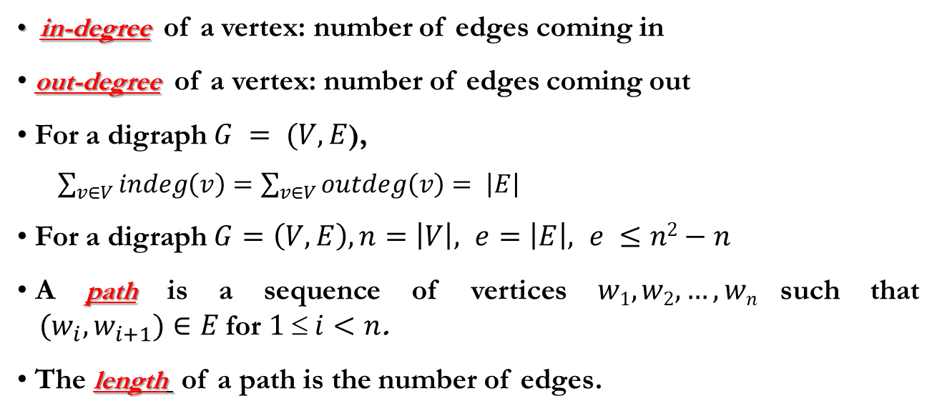
Graph: additional terms
in-degree of a vertex: number of edges coming in
out-degree of a vertex: number of edges coming out
For a digraph $G = (V, E$),
$\sum_{v∈V}{indeg\left(v\right)=\sum_{v∈V}{outdeg\left(v\right)= \left|E\right|}}$
For a digraph $G=\left(V, E\right), n=\left|V\right|, e=\left|E\right|, e ≤n2−n$
A path is a sequence of vertices $w1, w2,…, wn$such that ${(w}_{i}, w_{i+1})∈E$for $1  i<n$.
The length of a path is the number of edges.
1
3
2
4
One of the Paths from vertex 1 to 2: 1 3 4 2(length=3)

Slide 5
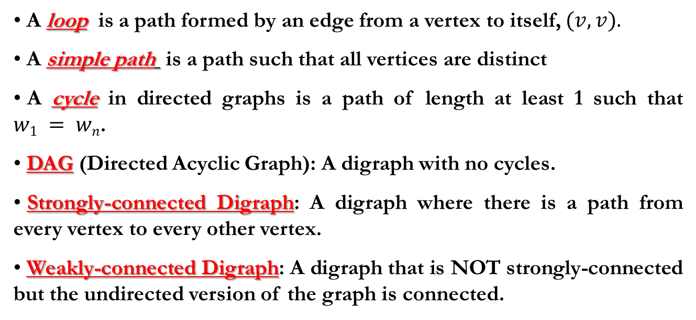
Graph: additional terms
A loop is a path formed by an edge from a vertex to itself, $(v, v).$
A simple path is a path such that all vertices are distinct
A cycle in directed graphs is a path of length at least 1 such that $w1 = wn$.
DAG (Directed Acyclic Graph): A digraph with no cycles.
Strongly-connected Digraph: A digraph where there is a path from every vertex to every other vertex.
Weakly-connected Digraph: A digraph that is NOT strongly-connected but the undirected version of the graph is connected.
1
3
1
3
1 3 4 1
2
4
2
4
Simple Path
Cycle

Slide 6
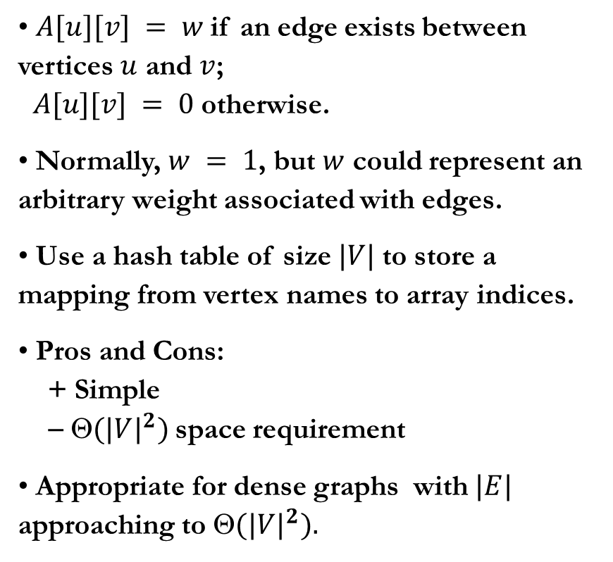
Graph Representation: Adjacency Matrix
$A[u][v] = w$if an edge exists between vertices $u$ and $v$; $A[u][v] = 0$otherwise.
Normally, $w = 1$, but $w$ could represent an arbitrary weight associated with edges.
Use a hash table of size $|V|$to store a mapping from vertex names to array indices.
Pros and Cons: + Simple − $({|V|}^{2})$space requirement
Appropriate for dense graphs with $|E|$ approaching to $({|V|}^{2}).$
1
2
3
1 2 3
1
2
3
1
1
1
0
0
1
0
1
0

Slide 7
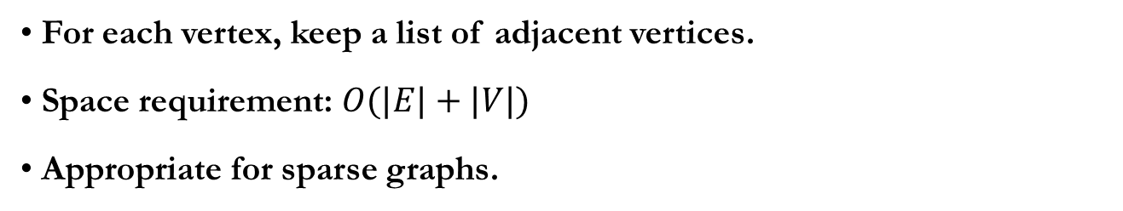
Graph Representation: Adjacency List
For each vertex, keep a list of adjacent vertices.
Space requirement: $O(|E|+|V|)$
Appropriate for sparse graphs.
adj[ ]
1
1
2
3
1
2
3
3
2
3
2

Slide 8
Common Graph Problems
Depth-First Search: generalization of preorder traversal
Breadth-First Search: search spreads out uniformly in all directions.
Topological Sort: ordering of vertices in a DAG.
Shortest Path Selection: airline/road route map
Network Flow Problem: determining the max amount of flow that can pass from a source vertex to a destination vertex
Minimum Spanning Tree: finding out a tree that connects all the vertices of a undirected (or directed) graph at lowest total cost.

Slide 9
Depth-first search
A generalization of preorder traversal
Can be used to provide the answers to several questions such as:
Is the graph connected ?
If not, what are its connected components ?
Does the graph has a cycle ?
During the DFS process, often vertices are represented as
White: not visited (discovered) yet
Gray: visited but its neighbors are not visited yet
Black: visited and all its neighbors are visited

Slide 10
Depth-First Search
/* the sequence number of visit */
int id=0;
DFS(Graph G)
{
for each vertex u ∈ V[G]
value[u] = 0; /* white */
for each vertex u ∈ V[G]
if (value[u] == 0)
VISIT(u);
}
VISIT(Vertex u)
{
value[u] = ++id; /* gray */
for each vertex v ∈ adj[u]
if (value[v] == 0)
VISIT(v);
/* black */
}
1
7
2
3
4
5
6
Construct adjacency list
Follow DFS sequence and
print the result
Run-time complexity ?
Notes:
Fig. 22.4

Slide 11
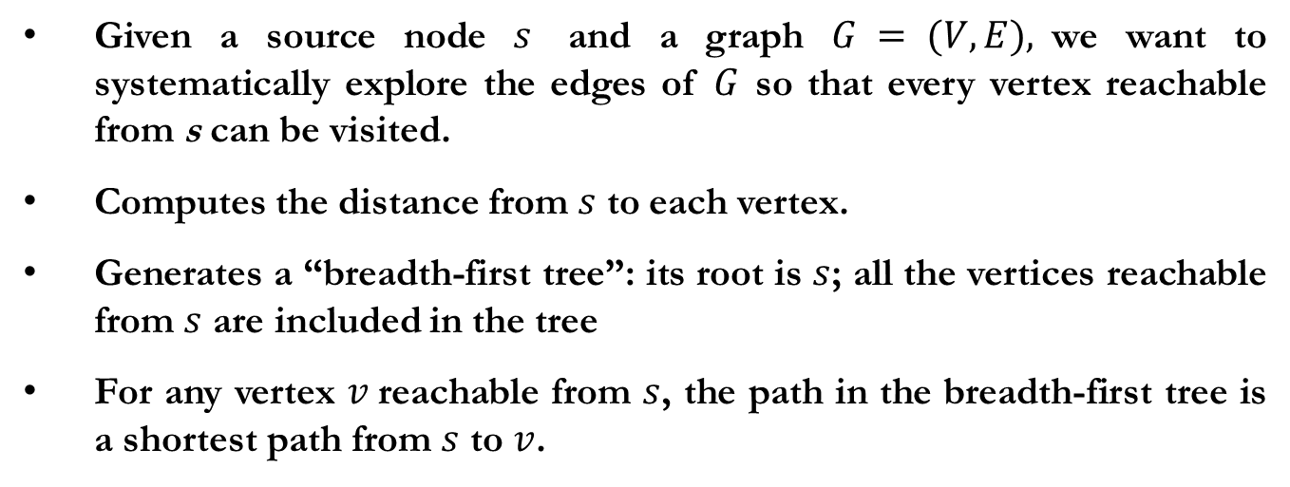
Breadth-First Search
Given a source node $s$ and a graph $G = (V, E),$we want to systematically explore the edges of $G$ so that every vertex reachable from s can be visited.
Computes the distance from $s$ to each vertex.
Generates a “breadth-first tree”: its root is $s$; all the vertices reachable from $s$ are included in the tree
For any vertex $v$reachable from $s$, the path in the breadth-first tree is a shortest path from $s$ to $v$.

Slide 12
Breadth-First Search
int id = 0;
BFS (Graph G, Vertex s)
{
Vertex t;
for each vertex u ∈ V[G] – {s}
value[u] = 0;
enqueue(Q, s);
while (!isEmpty(Q)) {
t= dequeue(Q);
value[t] = ++id;
for each vertex u ∈ adj[t]
if (value[u] == 0) {
enqueue(Q, u);
}
}
}
1
7
2
3
4
5
6
Construct adjacency list
Follow BFS sequence and
print the result
Run-time complexity ?
Notes:
Fig. 22.3

Slide 13
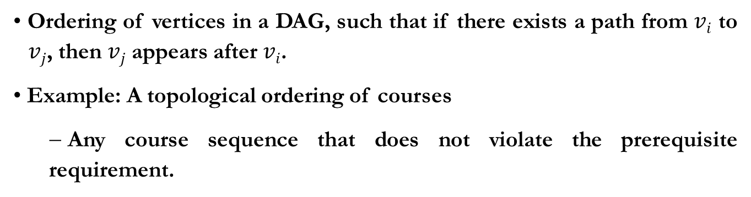
Topological Sort
Ordering of vertices in a DAG, such that if there exists a path from $vi$ to $vj$, then $vj$ appears after $vi$.
Example: A topological ordering of courses
Any course sequence that does not violate the prerequisite requirement.
프로그래밍방법론및실습
소프트웨어공학및설계
전산수학
컴퓨터기초및프로그래밍
자료구조및알고리즘
내장형시스템및실습
디지털논리설계및실습
컴퓨터시스템구조론
데이터통신
Notes:
예제 그림 추가할 것 (우리 과 이수체계)

Slide 14
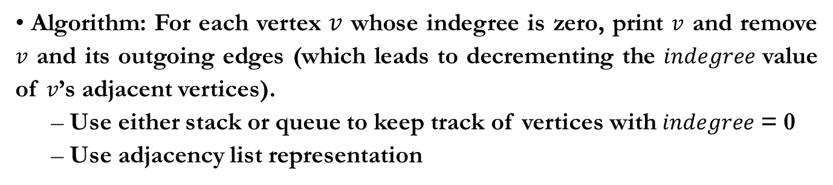
Topological Sort: Example
Algorithm: For each vertex $v$ whose indegree is zero, print $v$ and remove $v$ and its outgoing edges (which leads to decrementing the $indegree$ value of $v$’s adjacent vertices).
Use either stack or queue to keep track of vertices with $indegree$ = 0
Use adjacency list representation
Indegree = 0
Indegree = 1
Indegree = 0
1
2
2
Indegree = 0
5
3
4
5
3
4
Indegree = 1
Indegree = 1
Indegree = 3
Indegree = 1
Indegree = 4
Indegree = 0
3
4
Indegree = 1

Slide 15
Topological Sort: Code
Topsort (Graph G)
{
int Counter;
Vertex V, W;
for( Counter = 0; Counter < NumVertex; Counter++ )
{
V = FindNewVertexOfDegreeZero( );
if ( V == NotAVertex )
{
Error(“Graph has a cycle”);
break;
}
TopNum[V] = Counter;
for each W adjacent to V
Indegree[W]--;
}
}
Notes:
15
이것은 simple-minded algorithm O(V^2). A better algorithm in the next slide.
Indegree=0 인 vertex 가 없으면? cycle.

Slide 16
Topological Sort : Code
Topsort (Graph G)
{
Queue Q;
int Counter = 0;
Vertex V, W;
Q = CreateQueue(NumVertex);
MakeEmtpy(Q);
for each vertex V
if( Indegree[V] == 0 ) Enqueue(V, Q);
while( !IsEmtpy(Q) )
{
V = Dequeue(Q);
TopNum[V] = ++Counter;
for each W adjacent to V
if ( --Indegree[W] == 0 ) Enqueue(W, Q);
}
if ( Counter != NumVertex ) Error(“Graph has a cycle”);
DisposeQueue(Q);
}

Slide 17
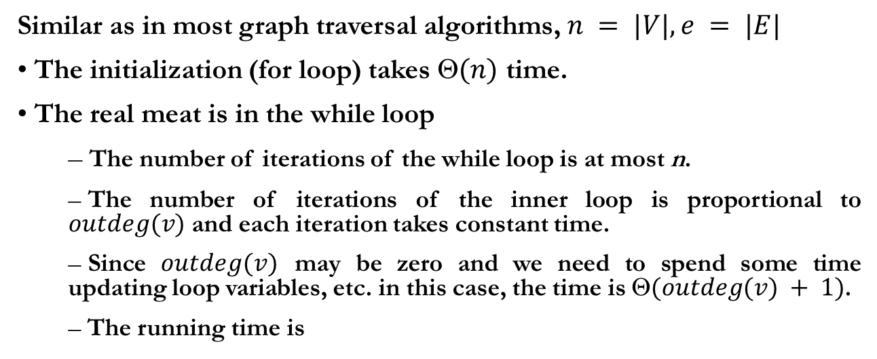
Running Time Analysis
Similar as in most graph traversal algorithms, $n = |V|, e = |E|$
The initialization (for loop) takes $(n)$ time.
The real meat is in the while loop
The number of iterations of the while loop is at most n.
The number of iterations of the inner loop is proportional to $outdeg(v)$ and each iteration takes constant time.
Since $outdeg(v)$ may be zero and we need to spend some time updating loop variables, etc. in this case, the time is $(outdeg(v) + 1)$.
The running time is

Slide 18
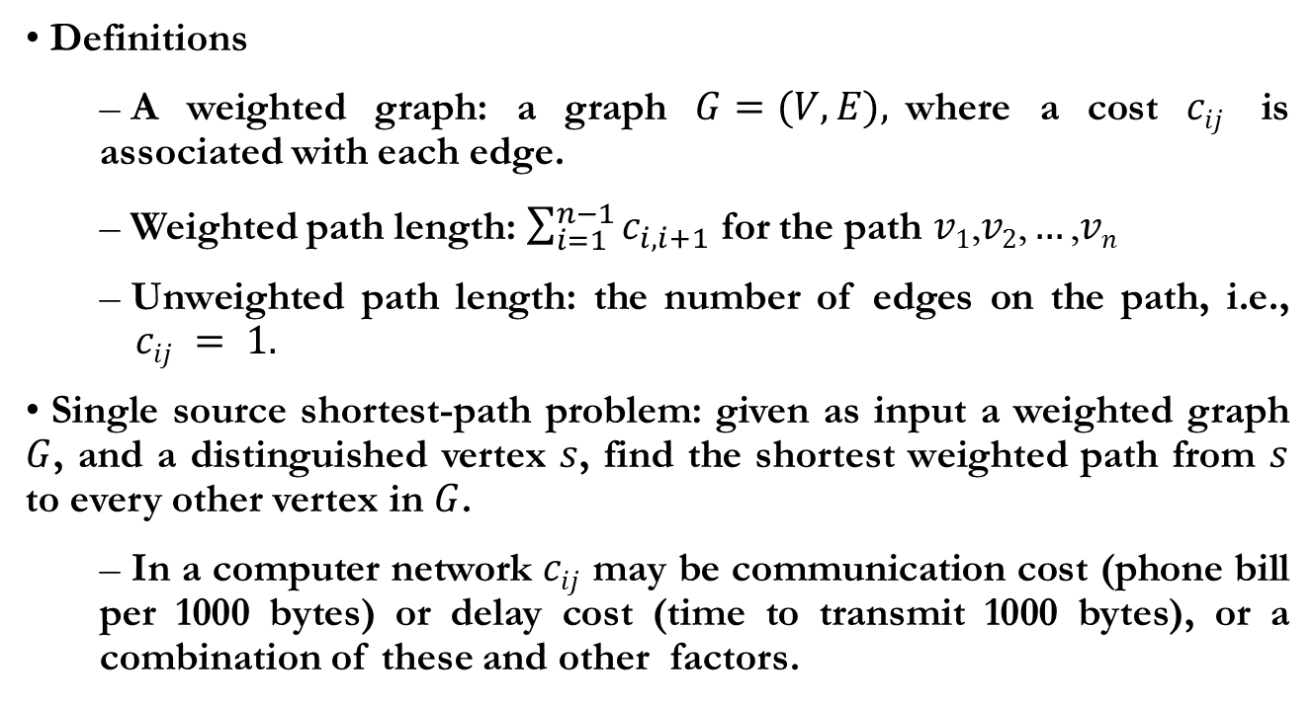
Shortest Path Algorithms
Definitions
A weighted graph: a graph $G=(V, E),$where a cost $cij$ is associated with each edge.
Weighted path length: $\sum_{i=1}^{n−1}{c_{i,i+1}}$ for the path $v1\text{,}v2\text{,}…\text{,}vn$
Unweighted path length: the number of edges on the path, i.e., $cij = 1.$
Single source shortest-path problem: given as input a weighted graph $G$, and a distinguished vertex $s$, find the shortest weighted path from $s$ to every other vertex in $G$.
In a computer network $cij$ may be communication cost (phone bill per 1000 bytes) or delay cost (time to transmit 1000 bytes), or a combination of these and other factors.

Slide 19
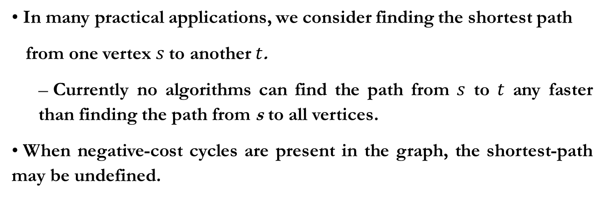
Shortest Path Algorithms : Examples
In many practical applications, we consider finding the shortest path
from one vertex $s$to another $t$.
Currently no algorithms can find the path from $s$ to $t$ any faster than finding the path from s to all vertices.
When negative-cost cycles are present in the graph, the shortest-path may be undefined.
2
5-4: 1
5-4-2-5-4: -5
3
-10
4
5
1

Slide 20
Unweighted Shortest Paths
1
2
1
2
2
0
3
4
5
6
7
1
Breadth-First Search (BFS): Vertices closest to the start are evaluated first, and the most distant vertices are evaluated last (Use queue to keep track of vertices to evaluate).
Data Structure: Queue

Slide 21
Unweighted Shortest Paths
Unweighted(Table T)
{
Q = CreateQueue(NumVertex); MakeEmpty(Q);
Enqueue(s, Q);
while( !IsEmtpy(Q) ) do
{
v = Dequeue(Q);
for each w adjacent to v
if( d[w] == infinity )
{
d[w] = d[v] + 1;
pred[w] = v;
Enqueue(w, Q);
}
}
DisposeQueue(Q);
}
Notes:
21
This is a pseudo code to find single-source shortest paths from s in an unweighted graph.
Infinity = not visited

Slide 22
Greedy Algorithm
Solves a problem in stages by doing what appears to be the best thing to do at each stage.
A working example: Giving out changes using the minimum number of coins/bills: count out in the order of 20 dollar bills, 10 dollar bills, 1 dollor bills, 25 cent coins, 10 cent coins, 5 cent coins, 1 cent coins...
Problem: Does not always work! (What if we have 12-cent coins when have to give the change of 15 cents ? -- One 12-cent coin and three 1-cent coins are not optimal!) → One 10-cent and one 5-cent
Dijkstra’s algorithm for finding the single-source shortest-path for weighted graphs.

Slide 23
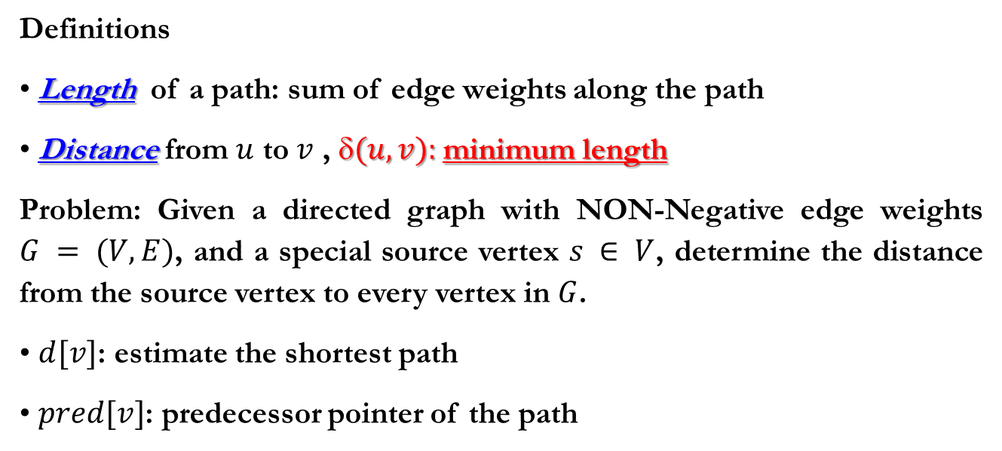
Dijkstra’s Algorithm
Definitions
Length of a path: sum of edge weights along the path
Distance from $u$ to $v$ , $(u, v):$minimum length
Problem: Given a directed graph with NON-Negative edge weights $G = (V, E)$, and a special source vertex $s ∈ V$, determine the distance from the source vertex to every vertex in $G$.
$d[v]$: estimate the shortest path
$pred[v]$: predecessor pointer of the path

Slide 24
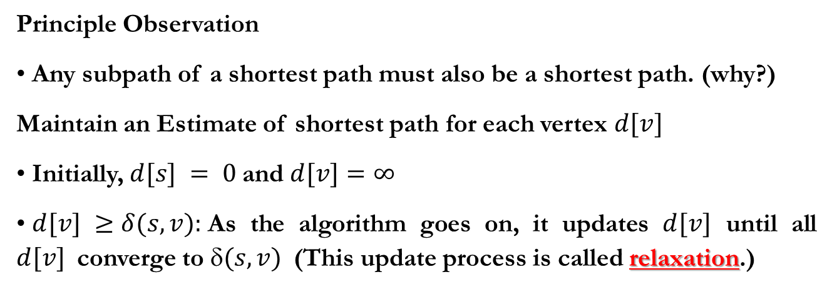
Optimality Structure and Relaxation
Principle Observation
Any subpath of a shortest path must also be a shortest path. (why?)
Maintain an Estimate of shortest path for each vertex $d[v]$
Initially, $d[s] = 0$and $d[v]=∞$
$d[v] ≥δ(s, v):$As the algorithm goes on, it updates $d[v]$ until all $d[v]$converge to $(s, v)$(This update process is called relaxation.)
if (d[u] + w[u, v] < d[v])
{
d[v] = d[u] + w[u, v];
pred[v] = u;
}

Slide 25
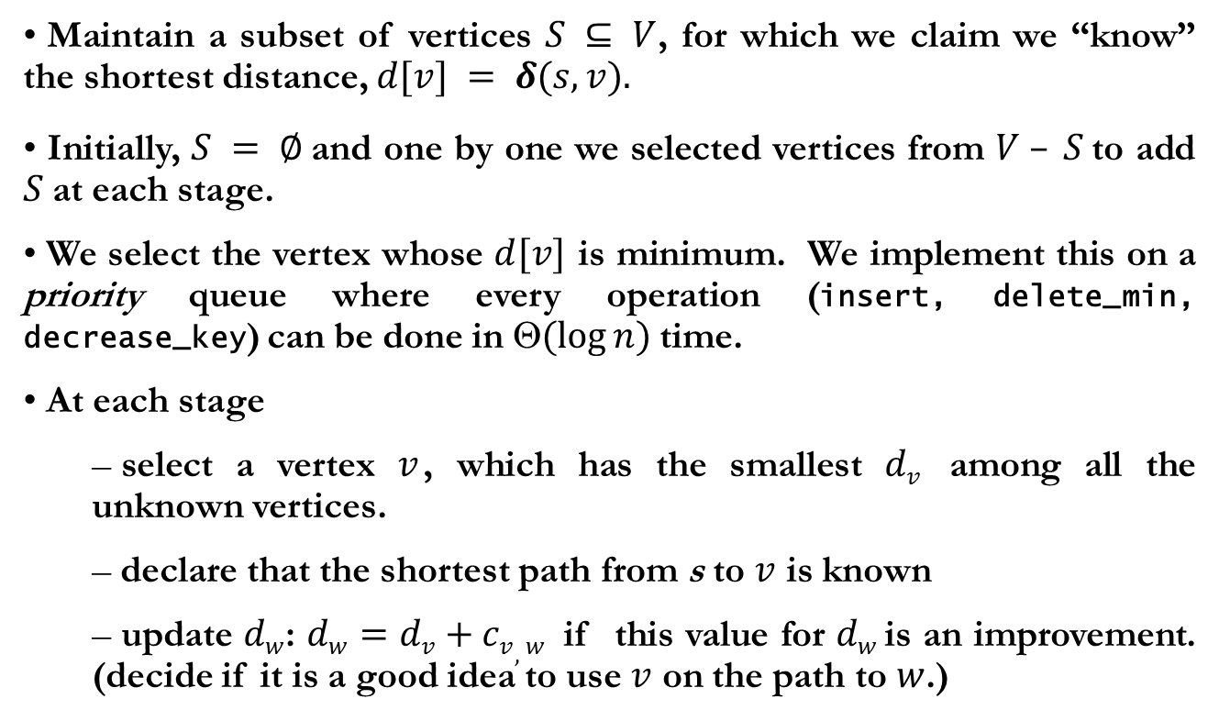
Repeated Relaxation
Maintain a subset of vertices $S ⊆ V$, for which we claim we “know” the shortest distance, $d[v] = δ(s, v).$
Initially, $S = ∅$and one by one we selected vertices from $V – S$to add $S$at each stage.
We select the vertex whose $d[v]$ is minimum. We implement this on a priority queue where every operation (insert, delete_min, decrease_key) can be done in $(log⁡n)$time.
At each stage
select a vertex $v$, which has the smallest $dv$ among all the unknown vertices.
declare that the shortest path from s to $v$ is known
update $dw$: $dw=dv+cv,w$ if this value for $dw$ is an improvement. (decide if it is a good idea to use $v$ on the path to $w$.)

Slide 26
Dijkstra’s Algorithm
Dijkstra(G=(V, E, w), s)
{
S = {};
for each v in V do
{ d[v] = +infinity;
pred[v] = nil;}
d[s] =0;
for each v in Adj[s] do
{ d[v] = w[s, v];
pred[v] = s;}
Add each vertex to priority queue Q;
While (Q is not empty) do
{ u = Delete_Min(Q); S = S + {u}; /* u is deleted (known vertex) */
for each v in Adj[u] do
{ if (d[u] + w(u, v) < d[v]) then
{ d[v] = d[u] + w(u, v);
pred[v] = u;
Decrease_Priority(Q, v);}
} /* End for */
} /* End while */
} /* End Dijkstra */

Slide 27
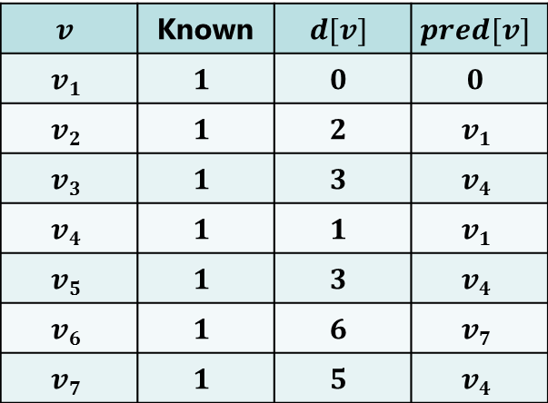
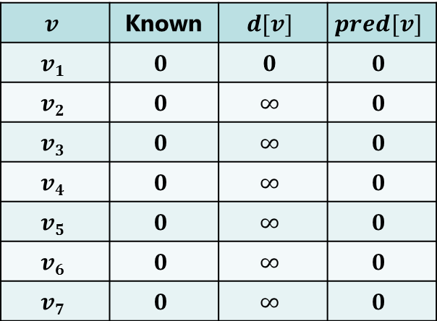
Dijkstra’s Algorithm: Example
1
2
2
4
1
3
10
3
2
4
2
5
5
8
4
6
6
7
1
Initial configuration
Final configuration
$$v$$ | Known | $$d[v]$$ | $$pred[v]$$
$$v1$$ | $$0$$ | $$0$$ | $$0$$
$$v2$$ | $$0$$ | $$∞$$ | $$0$$
$$v3$$ | $$0$$ | $$∞$$ | $$0$$
$$v4$$ | $$0$$ | $$∞$$ | $$0$$
$$v5$$ | $$0$$ | $$∞$$ | $$0$$
$$v6$$ | $$0$$ | $$∞$$ | $$0$$
$$v7$$ | $$0$$ | $$∞$$ | $$0$$
$$v$$ | Known | $$d[v]$$ | $$pred[v]$$
$$v1$$ | $$1$$ | $$0$$ | $$0$$
$$v2$$ | $$1$$ | $$2$$ | $$v1$$
$$v3$$ | $$1$$ | $$3$$ | $$v4$$
$$v4$$ | $$1$$ | $$1$$ | $$v1$$
$$v5$$ | $$1$$ | $$3$$ | $$v4$$
$$v6$$ | $$1$$ | $$6$$ | $$v7$$
$$v7$$ | $$1$$ | $$5$$ | $$v4$$

Slide 28
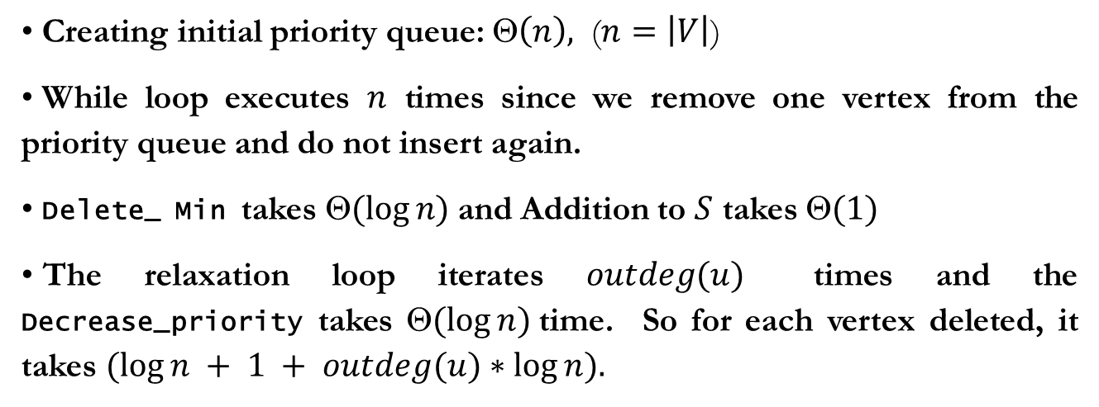
Dijkstra’s Algorithm: Running Time
Creating initial priority queue: $\left(n\right),$ ($n=\left|V\right|$)
While loop executes $n$ times since we remove one vertex from the priority queue and do not insert again.
Delete_ Min takes $(log⁡n)$and Addition to $S$ takes $(1)$
The relaxation loop iterates $outdeg(u)$ times and the Decrease_priority takes $(log⁡n)$time. So for each vertex deleted, it takes $(log⁡n + 1 + outdeg(u)∗log⁡n).$
Notes:
28
Fibonacci heap을 사용하면 O(e + n log n)

Slide 29
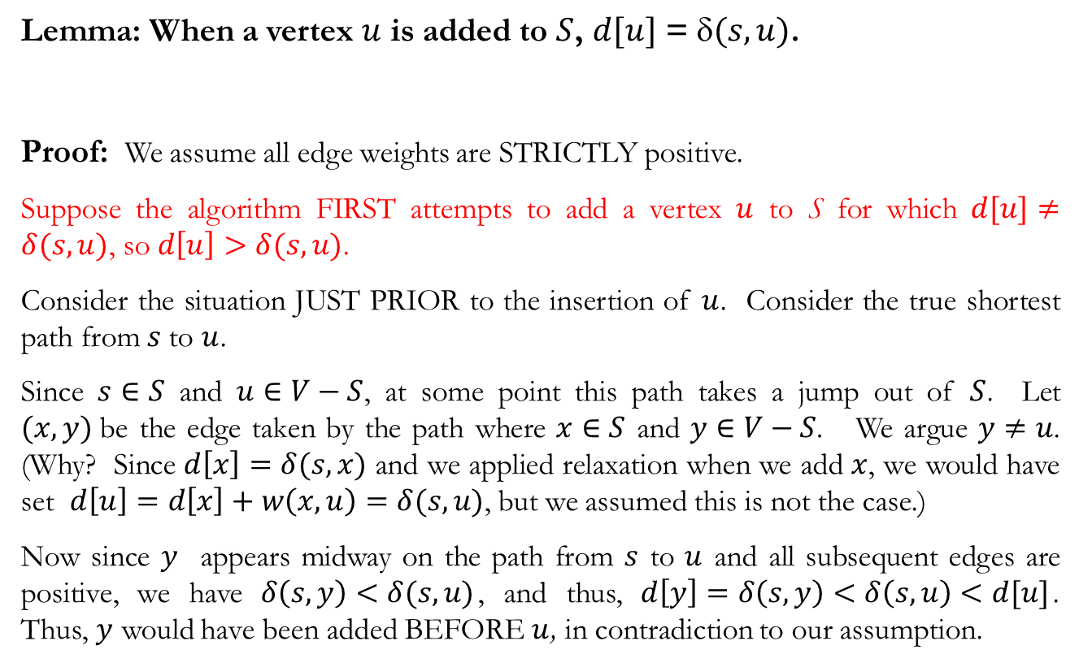
Correctness
Lemma: When a vertex $u$ is added to $S$, $d[u]$ = $(s, u)$.
Proof: We assume all edge weights are STRICTLY positive.
Suppose the algorithm FIRST attempts to add a vertex $u$ to S for which $d[u]≠δ(s,u)$, so $d\left[u\right]>δ(s,u)$.
Consider the situation JUST PRIOR to the insertion of $u$. Consider the true shortest path from $s$to $u$.
Since $s∈S$ and $u∈V−S$, at some point this path takes a jump out of $S$. Let $(x, y)$be the edge taken by the path where $x∈S$ and $y∈V−S$. We argue $y≠u$. (Why? Since $d\left[x\right]=δ(s,x)$ and we applied relaxation when we add $x$, we would have set $d\left[u\right]=d\left[x\right]+w\left(x,u\right)=δ(s,u)$, but we assumed this is not the case.)
Now since $y$ appears midway on the path from $s$ to $u$ and all subsequent edges are positive, we have $δ\left(s,y\right)<δ(s,u)$, and thus, $d\left[y\right]=δ\left(s,y\right)<δ\left(s,u\right)<d[u]$. Thus, $y$ would have been added BEFORE $u$, in contradiction to our assumption.

Slide 30





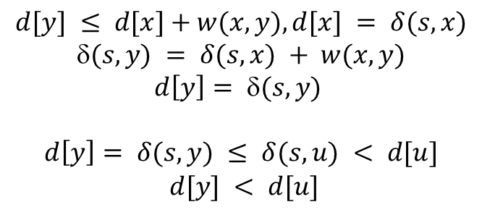

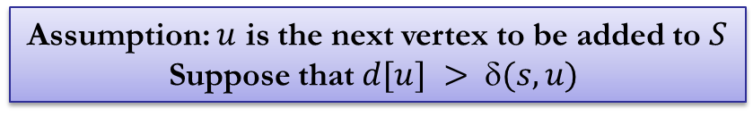
Correctness
Assumption: $u$ is the next vertex to be added to $S$
Suppose that $d[u] > (s, u)$
$$V$$
$$S$$
$$u$$
$$s$$
$$x$$
$$y$$
$$d[y] ≤ d[x]+w(x, y), d[x] = δ(s, x)$$
$$(s, y) = δ(s, x) + w(x, y)$$
$$d\left[y\right]= δ(s, y)$$
$$d\left[y\right]= δ(s, y) ≤ δ(s, u) < d[u]$$
$$d[y] < d[u]$$

Slide 31
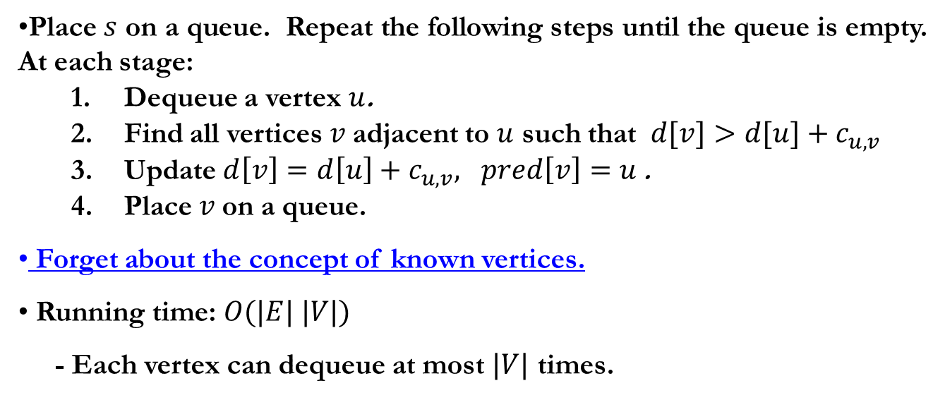
Shortest Path in Presence of Negative Edge Cost (Bellman-Ford Algorithm)
Place $s$ on a queue. Repeat the following steps until the queue is empty. At each stage:
Dequeue a vertex $u$.
Find all vertices $v$adjacent to $u$ such that $d[v]>d[u]+c_{u,v}$
Update$d\left[v\right]=d\left[u\right]+c_{u,v}, pred\left[v\right]=u$.
Place $v$on a queue.
Forget about the concept of known vertices.
Running time: $O(|E| |V|)$
- Each vertex can dequeue at most $|V|$ times.
Notes:
- negative edge cost가 있을 때 Dijkstra 알고리즘을 쓸 수 없는 이유?
negative edge cost의 크기 만큼 offset 시켜서 모든 edge cost를 nonnegative로 만들고 Dijkstra 알고리즘을 쓰면 안 되는 이유? (single edge는 relative cost의 순서가 ok. 그러나, (negative cost edge를 포함하는) path에 대해서는?

Slide 32
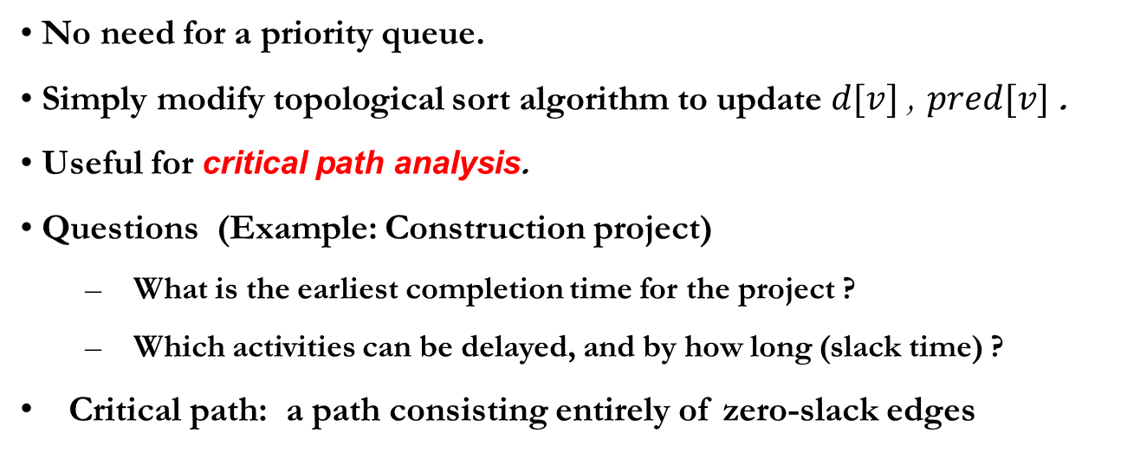
Acyclic Graphs
No need for a priority queue.
Simply modify topological sort algorithm to update $d[v]$, $pred[v]$.
Useful for critical path analysis.
Questions (Example: Construction project)
What is the earliest completion time for the project ?
Which activities can be delayed, and by how long (slack time) ?
Critical path: a path consisting entirely of zero-slack edges
Activity-node graph
C(3)
A(3)
F(3)
start
D(2)
H(1)
finish
B(2)
G(2)
E(1)
K(4)
Notes:
32
what’s the earliest completion time? EC1=0, ECw = max (ECv + cost(v,w)) for all (v, w)
which activities can be delayed without affecting completion time? by how long? LCn=ECn, LCv = min (LCw - c(v,w)) for all (v,w)

Slide 33
Acyclic Graphs
Activity-node graph
C(3)
A(3)
F(3)
start
D(2)
H(1)
finish
B(2)
G(2)
E(1)
K(4)
Event Node Graph
2
C/3
4
0
A/3
0
7’
F/3
7
0
D/2
0
H/1
10
1
6’
6
0
0
10’
B/2
0
8’
G/2
8
0
3
E/1
5
0
K/4
9
Notes:
33
what’s the earliest completion time? EC1=0, ECw = max (ECv + cost(v,w)) for all (v, w)
which activities can be delayed without affecting completion time? by how long? LCn=ECn, LCv = min (LCw - c(v,w)) for all (v,w)

Slide 34

Earliest Completion Time
${EC}_{1}=0, {EC}_{w}=max({EC}_{v}+c_{v,w}))$ for all $(v, w)$
3
6
0
2
C/3
4
6
9
A/3
0
7’
F/3
7
0
9
10
0
3
5
0
H/1
1
6’
D/2
6
10’
10
B/2
0
0
5
7
0
2
8’
G/2
8
0
3
E/1
3
0
7
5
9
K/4
Latest Completion Time
${LC}_{n}={EC}_{n}, {LC}_{v}=min({LC}_{w}−c_{v,w}))$ for all $(v, w)$
C/3
0
2
4
F/3
A/3
0
7’
7
0
3
D/2
6
0
H/1
10
1
6’
6
0
6
9
0
10’
B/2
0
8’
G/2
8
0
9
10
0
4
6
0
3
E/1
9
9
5
7
K/4
4
5
9
$${Slack}_{(v,w)}={LC}_{w}−{{EC}_{v}−c}_{v,w}$$
2
C/3/0
4
A/3/0
7’
F/3/0
7
D/2/1
10’
H/1/0
10
1
6’
6
B/2/2
8’
G/2/2
8
3
E/1/2
9
5
K/4/2

Slide 35
All-Pairs Shortest Paths
Of course, we could use Dijkstra’s algorithm applied to each vertex, but we take an alternative algorithm.
Floyd-Warshall Algorithm (Section 10.3.4 in Textbook)
Easy to implement
Work for negative cost edges (no cycles!)
A Dynamic Programming Algorithm, not a Greedy algorithm
Use Adjacency matrix representation (since the result is an $n  n$matrix of distances).

Slide 36
Dynamic Programming
Like Divide-and-Conquer, Dynamic Programming solves problems by combining solutions of sub-problems.
Divide-and-Conquer: when sub-problems are independent
Dynamic Programming: when sub-problems are NOT independent, that is, sub-problems share sub-sub-problems; if Divide-and-Conquer is applied, it will repetitively solve the common sub-problems.
Dynamic Programming solves its sub-problem just once and saves its answer in a table, thus avoiding the work of recomputing the answer every time the sub-problem is encountered.
“Programming” means a tabular method, not writing code.

Slide 37
Application of Dynamic Programming
Typically applied to Optimization problems.
Characterize the structure of an optimal solution
Recursively define the value of an optimal solution
Compute the value of an optimal solution in a bottom-up fashion

Slide 38
All-Pairs Shortest Paths: Input and Output
Input is an $n×n$matrix of weights
$w[i, j]$= 0 (if $i = j)$
= $w(i, j)$(if $i≠j$and $(i, j) ∈E$)
= $+$ (if $i ≠ j$ and $(i, j) ∉ E$)
Output is an $n×n$matrix $d[i, j],$where $d[i, j] = δ(i, j)$

Slide 39
All-Pairs Shortest Paths: Basic Idea
We view the input as a distance matrix $d0[i, j]$where paths are allowed to use a single edge. The final distance matrix is obtained by computing a series of approximate distance matrices.
$d0[i, j], d1[i, j], …, dn[i, j],$in each case the approximation gets better ($d0[i, j] = w[i, j] and dn[i, j] = δ(i, j)).$How to define $dk[i, j]$???
The definition of Floyd-Warshall
For a path $p = <v1, v2, …, vl>,$we say $v2, v3, …,v_{l−1 }$are intermediate vertices (A path with a single edge has NO intermediate vertices)
Define $dk[i, j]$the shortest path from $i$to $j$ such that all the intermediate vertices are chosen from the set $\{1, 2, …, k\}$

Slide 40
Computing Distance by Dynamic Programming
Compute the matrix $dk$ assuming we have already computed the previous matrix $d0, d1, …d^{k−1}$
Computation of $dk[i, j]$
Don’t go through $k$: $dk[i, j] = dk 1[i, j]$
Go through $k:$ $dk[i, j] = dk 1[i, k] + dk 1[k, j]$
Dynamic Programming Rule
$d0[i, j]$= $w(i, j)$
$dk[i, j]$= $min⁡(dk 1[i, j], dk 1[i, k] + dk 1[k, j])$
The final answer is $dn[i, j]$since the rule allows all possible vertices as intermediate vertices.

Slide 41
Floyd-Warshall Algorithm
Floyd-Warshall(w[1..n, 1..n])
{
for i = 1 to n do
for j = 1 to n do
{
d[i, j] = w[i, j];
pred[i, j] = nil;
}
for k = 1 to n do
for i = 1 to n do
for j = 1 to n do
if d[i, k] + d[k, j] < d[i, j] then
{
d[i, j] = d[i, k] + d[k, j];
pred[i, j] = k;
}
}
Notes:
d^k[i, k]=d^k-1[i, k] 이고 d^k[k, j]=d^k-1[k, j] 이므로 d[i, k], d[k, j]는 k번째 iteration에서 변하지 않는다. 따라서 저장할 필요가 없다.

Slide 42
Example
4
10
1
12
5
4
5
4
2
3
3
$d0[4, 5]$= +∞
$d1[4, 5]$= 22 (4, 1, 5), ($d1[2, 5]$= 17)
$d2[4, 5]$= 21 (4, 2, 1, 5), ($d2[4, 3]$= 7)
$d3[4, 5]$= 11 (4, 2, 3, 5)
$d4[4, 5]$= 11 (4, 2, 3, 5)
$d5[4, 5]$= 11 (4, 2, 3, 5)
Find yourself all other pairs shortest paths

Slide 43
Minimum Spanning Trees (MST)
A common problem in communication networks and circuit design
Connecting together a set of nodes (communication sites or circuit components) by a network of minimal total length (length is the sum of lengths of connecting wires)
Minimum Spanning Tree (MST) Problem
Given a connected, undirected graph $G=(V, E),$a spanning tree $T$is an acyclic subset of edges $T  E$that connects all vertices together.
The cost of a spanning tree $T$ is $w\left(T\right)=\sum_{(u,v)∈T}{w(u,v)}$.
A minimum spanning tree is the one with minimum cost.
Notes:
MST: 그래프에 속한 모든 정점을 싸이클 없이 최소 비용으로 연결한 트리 (그래프의 모든 정점이 reachable 해야 만 존재함)
Tree: acyclic
Span: 모든 정점을 연결
Minimum: 최소 비용

Slide 44
MST: An Example
$$G=(V,E)$$
MST
2
2
1
2
1
2
4
1
3
10
1
3
2
4
7
5
2
3
4
5
5
8
4
4
6
6
6
1
7
6
1
7
Greedy Algorithms for the MST problem
Prim’s algorithm: similar to Dijkstra’s algorithm
– update: $d_{w}=min(d_{w}, c_{w,v})$, $(\left(n+e\right)log⁡n)$
Kruskal’s algorithm: $(e log⁡n)$
Notes:
Prim algorithm: S={nodes in the tree}

Slide 45
Prim’s Algorithm
Basically identical to Dijkstra’s algorithm
The algorithm maintains a set of vertices that have already been included in the tree.
At each stage, the algorithm finds a new vertex to add to the tree by choosing the edge $(u, v)$such that the cost of $(u, v)$ is the smallest among all edges where $u$ is in the tree and $v$ is not.
For each vertex v, we keep $d[v]$ and $pred[v]$ such that
$d[v]$: the weight of the shortest edge connecting $v$ to a known vertex
$pred[v]$: the last vertex to cause a change in $d[v]$

Slide 46
Prim’s Algorithm: Pseudo Code
Prim (G = (V, E))
{
MST = {};
for each v in V do Create_Set({v});
Sort the edges of E in increasing order of weights;
for each edge (u, v) in E in weight order do
{
if ( Find(u) != Find(v) ) THEN
{
MST = MST + {(u, v)};
Union(Find(u), Find(v));
} /* END IF */
} /* END FOR */
} /* END Prim */
Prim(G=(V, E, w), s)
{
MST = {};
for each v in V do
{ d[v] = +infinity;
pred[v] = nil;}
d[s] =0;
for each v in Adj[s] do
{ d[v] = w[s, v];
pred[v] = s;}
Add each vertex to priority queue Q;
While (Q is not empty) do
{ u = Delete_Min(Q); MST = MST + {u};
for each v in Adj[u] do
{ if (w(u, v) < d[v]) then
{ d[v] = w(u, v);
pred[v] = u;
Decrease_Priority(Q, v);}
} /* End for */
} /* End while */
} /* End Prim */

Slide 47
Prim’s Algorithm: Example
2
2
1
2
1
2
4
1
3
10
1
3
2
4
7
5
2
3
4
5
5
8
4
4
6
6
6
1
7
1
6
7
Initial configuration
1
2
$$v$$ | $$Known$$ | $$d[v]$$ | $$pred[v]$$
$$v1$$ | 0 | 0 | 0
$$v2$$ | 0 | $$∞$$ | 0
$$v3$$ | 0 | $$∞$$ | 0
$$v4$$ | 0 | $$∞$$ | 0
$$v5$$ | 0 | $$∞$$ | 0
$$v6$$ | 0 | $$∞$$ | 0
$$v7$$ | 0 | $$∞$$ | 0
3
4
5
6
7

Slide 48
Kruskal’s Algorithm
Greedy selection at each stage
Cheapest edge that does not introduce a cycle
Methods to detect a cycle
Union-Find ADT that supports $O(log⁡n)$operation
Make each vertex a partition of itself ( Init( ) )
Determine if two vertices are in the same set ( Find( ) )
Union two sets into a new set using Union( )
Selection of an edge unions two sets of vertices

Slide 49
Kruskal’s Algorithm: Pseudo Code
Kruskal (G = (V, E))
{
MST = {};
for each v in V do Create_Set({v}); /* $O\left(n\right),n=\left|V\right|\text{∗/}$
Sort the edges of E in increasing order of weights;
for each edge (u, v) in E in weight order do {
/* Find(w) means a spanning tree which w belongs to */
if ( Find(u) != Find(v) ) THEN {
MST = MST + {(u, v)}; /* accept the edge (u, v) */
Union(Find(u), Find(v));
} /* END IF */
} /* END FOR */
} /* END Kruskal */
Notes:
For loop는 accept된 edge의 수가 |V|-1 일 때 끝나도록 최적화 가능

Slide 50
Kruskal’s Algorithm: Example
1
2
2
1
2
1
2
4
1
3
10
1
1
3
2
4
7
5
3
4
5
3
4
5
5
8
4
6
1
6
7
1
7
6
7
6
Initially, 7 separate sets
(2,4), (1,3) rejected !!!
1
2
2
1
2
2
1
2
2
1
1
1
2
2
3
4
5
3
4
5
3
4
5
4
1
1
1
6
7
6
7
6
7
1
2
2
(3,6) rejected !!!
Then, accept (5, 7)
(4,5), (4,6), (2,5) rejected !!
1
3
2
4
5
4
6
1
Since # of accepted edges=(|V|-1), the algorithm terminates.
6
7

Slide 51
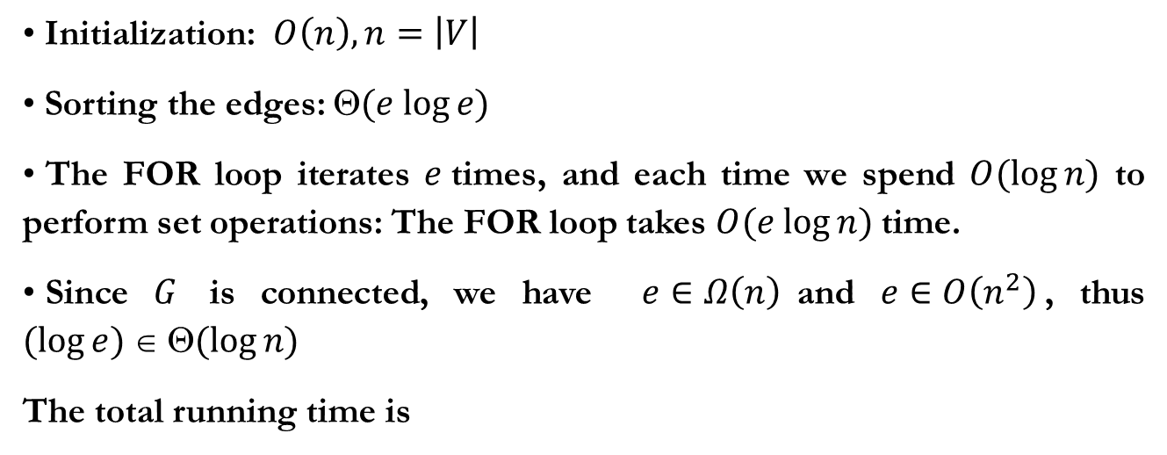
Running Time of Kruskal’s Algorithm
Initialization: $O\left(n\right),n=\left|V\right|$
Sorting the edges: $(e log⁡e)$
The FOR loop iterates $e$times, and each time we spend $O(log⁡n)$ to perform set operations: The FOR loop takes $O(e log⁡n)$time.
Since $G$ is connected, we have $e∈Ω\left(n\right)$and $e∈O\left(n^{2}\right)$, thus $(log⁡e)  (log⁡n)$
The total running time is

